Slide 1
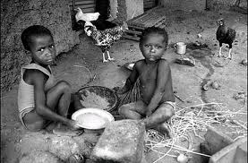
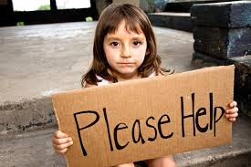
Standard of Living
Developed Countries compared to Less Developed Countries

Slide 2
How can we measure standard of living?

Slide 3


Human Development Index
This is the United Nations ranking of countries to better understand economic and social development of the world. The HDI is calculated based on
  Life Expectancy
  Adult Literacy
  GDP (gross Domestic Product) per capita
  Who are the 2012 top 10 countries?
  Who are the bottom 10 countries?
  Canada ranked #1 from 1994 – 2000. Where does Canada rank now?

Slide 4
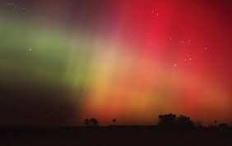
Problems with Human Development index
Some countries may not have accurate records
GDP per Capita not accurate if wealth is in hands of a few billionaires
Government help / agencies can increase standard of living and not be reflected in the numbers
Doesn’t include info in nutrition, healthcare, status of women, quality of life, etc. that lower standard of living
Does not include calculation of poverty line in each country (money goes farther in some places)
  What is the poverty line?
  World Bank uses $1.25 per day
  Canada: spending more than 56% of income on food/ shelter

Slide 5
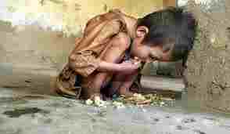
Other Ways to Measure Poverty
U5MR: Under Five Mortality Rate
  # of children who die before the age of 5
  Most deaths in LCDs are due to malnutrition
  U5MR can be 50x greater in Less developed countries than in developed countries
  UNICEF created the Progress of Nations Report on the Welfare of the child in 1998
    Measures the risk to children on a scale of 0-100 (1 being low risk, 100 is extremely high risk ) based on:
          Infant mortality rate
          % of underweight children
          % not attending Primary school
          Risk from armed conflict
          Risk of contracting HIV/AIDS
Result:
Europe = 6
Africa = 61

Slide 6





Organizations that want to help
United Nations
Government Agencies
(CIDA – Canadian International Development Agency)
Non-Government Agencies
  Free the Children
  Red Cross
  Amnesty international

Slide 7
Why are some countries so wealthy while others are so poor?
What defines a Less Developed Country?
History of Colonization
Watch
“Africa in the 21st Century”
and “Latin America in the 21 century”

Slide 8
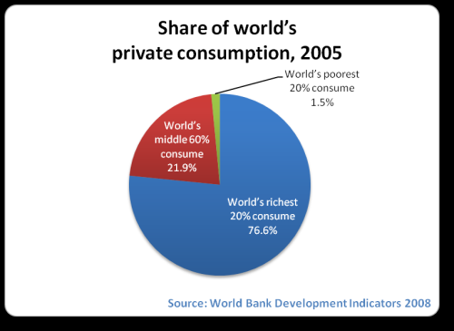
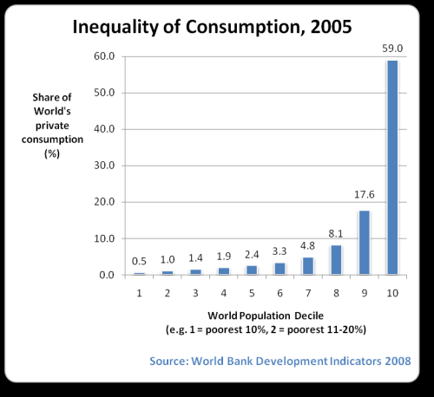
Uneven Consumption

Slide 9
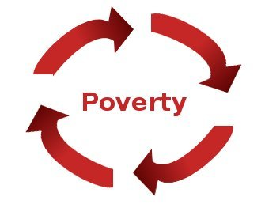

Poverty Cycle / Trap
See handout / p. 347 of textbook
What is the poverty Cycle?
What are possible solutions to the poverty trap? Where and how should we intervene?

Slide 10
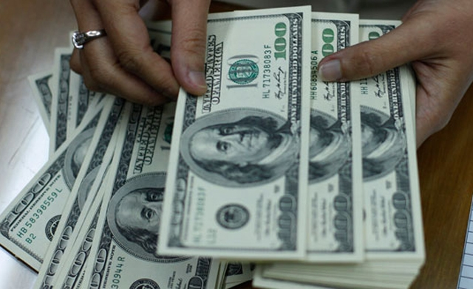

Debt
Highly indebted Poor Countries (HIPC)
Where did the Debt come from?
International Monetary Fund (IMF) and World Bank created as branch of UN after WW2 to assist / loan money to developing nations to improve living standards
Tied aid – money given with conditions (must allow use of land, or resource, or restrict exports, etc.)
****Canada, and others, have now forgiven the loans to HIPC ***

Slide 11

What happened to the Money? Why did it fail?
Money used for Mega projects (dams, irrigation) that caused more environmental damage than economic good
2. Corrupt governments = not all money goes to places of need
3. Loans needed to be paid back
  Developed Nations insist on Cash crops to export to pay debt = less food
  Pay all / most profit to debt repayment, not improving economy
  4. Resources controlled by Foreign Multinational Corporations = money not going to farmers or to less developed country
  5. Natural disasters and civil war = increase poverty

Slide 12
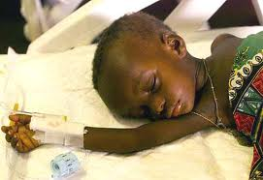

Disease – HIV/AIDS
2000 - 35 million people had AIDS
- 8 million orphans due to AIDS
- 16,000 more are infected each day
Of 14 million who have died due to AIDS by the year 2000, 11 million are from Africa, and ¼ were children
Less developed countries have no resources to deal with the epidemic
Ex. Zimbabwe had 26% of population infected = ½ their health care budget

Slide 13
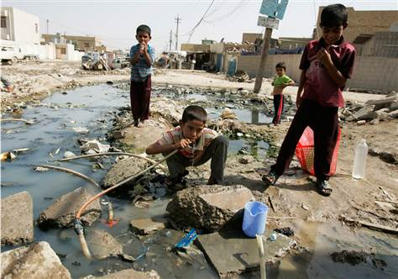

Water
1999 – 1.2 billion people lacked safe, clean drinking water (contaminated with human and industrial waste)
Water prioritized for agriculture and “cash crops” for export
Contaminated water = disease and death
  80% of world’s diseases caused by bad water,
  ex. Parasites, cholera, malaria, typhoid, leprosy, bilharzia all breed in water

Slide 14

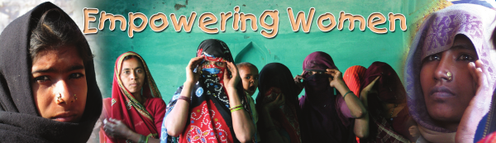
Lower status of Women
Male dominated societies
Treated as property (no legal rights, can be beaten or even killed)
Women suffer from Malnutrition (eat after men)
Work long hard hours to feed family – no time to improve life (see fig. 14-15 p. 351)
Lower education / literacy
Marry very young
Many children / births
How to help?
Studies show educated women marry later and have less children, improving the quality of life for the entire family (children survive, better chance at being properly nourished, help break poverty trap)

Slide 15
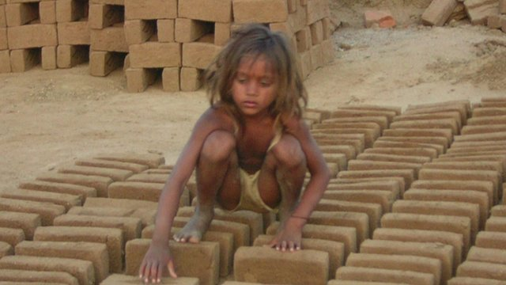
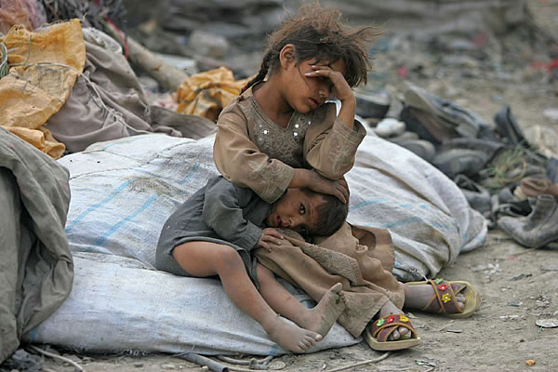
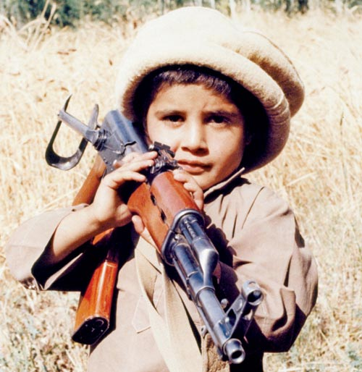
Children
Easy victims (disease, famine, war, death)
At risk for exploitation (child labour, sex trade, child soldiers)
1999 – 540 million children lived near land mines, ethnic cleansing, civil war
1996 – 250 million children between ages 5-14 were working

