Slide 1
Human Rights
Understanding the Universal Declaration of Human Rights

Slide 2
What are Human Rights?
Class 1: Defining Human Rights: Auction

Slide 3
Should life ever be hierarchized? Are all people Equal?
Is one life always equal to another? Is one life more valuable or more disposable than another?

Slide 4
Human rights Auction
Highlight 3 most important rights
Underline 3 least important rights
Add 3 you deem are missing
Compare with a neighbor
Auction!

Slide 5
Auction Debrief:
What was most expensive? Least? Why?
What were the “added” rights? Why?
What role did wealth play? Is that a fair?
Thoughts?

Slide 6
UN: history of rights (DVD)
What’s Important?
( min. 3 items)
Why?
(3 reasons for each point)

Slide 7
Universal Declaration Of Human Rights
Class 2/3

Slide 8
Philosophical Chairs

Slide 9
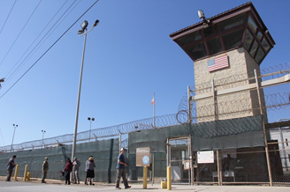
Is it ok to use torture to gain information in the fight against terrorism?
What defines a terrorist?
The Right to Freedom from Torture

Slide 10
Is prostitution a choice?
The Right to Freedom from Slavery

Slide 11
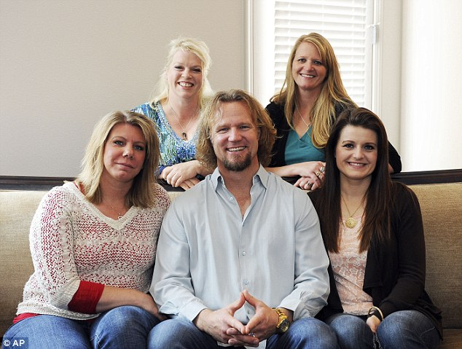
Can a marriage be polyamorous?
The Right to Marry and Have a Family

Slide 12
Do you agree with the new “death with dignity” law? (dr. assisted Suicide)
The Right to life

Slide 13
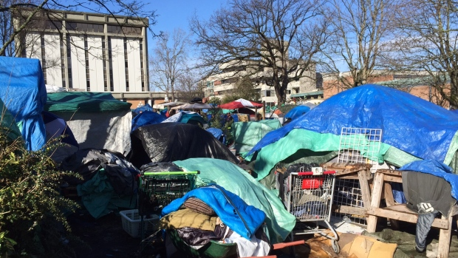
Should the BC government provide housing for all homeless?
The Right to Social Security

Slide 14
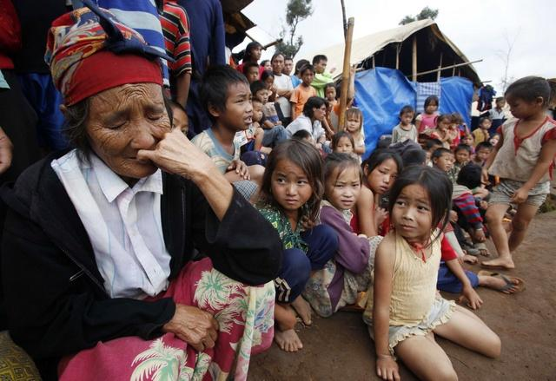
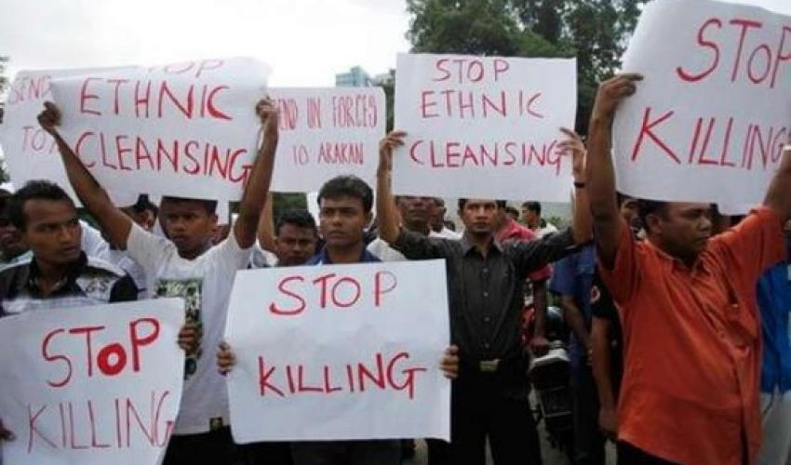
An “Ethnic Cleansing” is currently happening in Myanmar (against ethnic muslims - the Rohingya) Should countries be required to let in Refugees?
Right to Life
Right to seek a safe place to live

Slide 15
What is happening in the world?
What is your picture about?
What is the cause?
What is the method of advocacy?
- - - - - - - - - - - - - - - - - - - - - - - -
What current events did you use as examples?

Slide 16
Global Climate change protest Friday, Sept. 20
(Sept. 20 – UN)
https://www.theguardian.com/environment/2019/sep/21/across-the-globe-millions-join-biggest-climate-protest-ever
(Interview with Greta)
https://www.cnn.com/videos/world/2019/09/20/greta-thunberg-profile-bill-weir-climate-pkg-vpx.cnn
Do we have the RIGHT to a clean Environment? Clean Air? Clean Water?
Is this in the Right To Life (Article 3)?
Greta
Thunberg

Slide 17
ACTIVITY
Match the Article to the Human right
(Pink Cards – Human rights with Green Cards – current event examples)
What do you think? Discuss the article

Slide 18
Case Study: Is Shelter a Human Right?
Class 4

Slide 19
Quick Write: Journal
your opinion:
Is Shelter a Human Right?
Why are people Homeless?
What should we do about it?

Slide 20
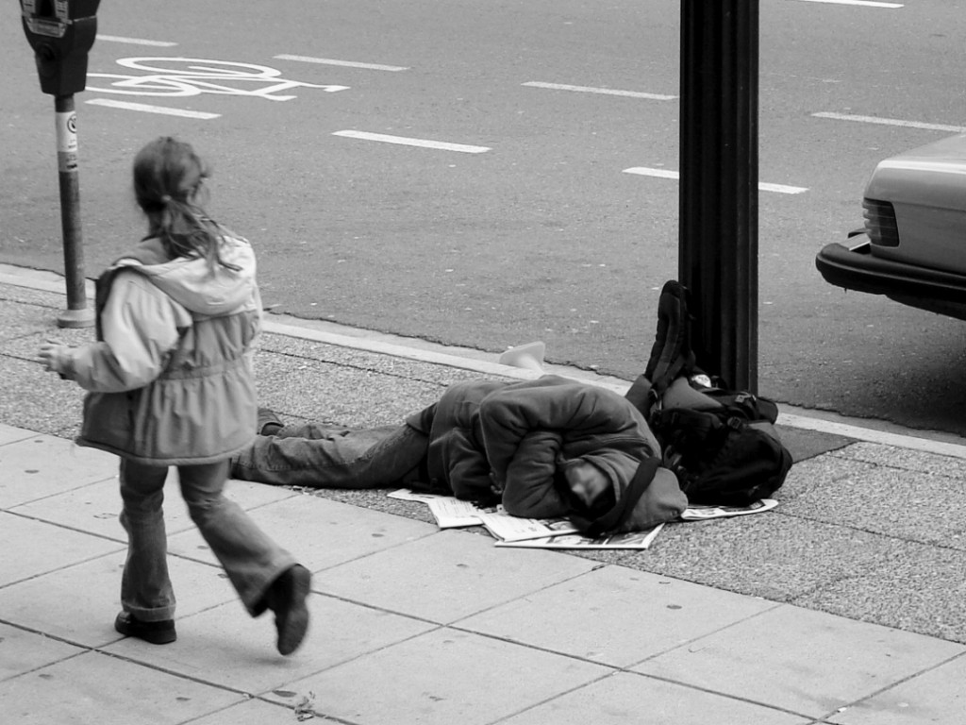
Class Sticky Notes: Board Organizer
What do you think?
What is Homelessness? (definition)
Who is homeless?
What causes homelessness?
How can homelessness be solved?

Slide 21
What causes Poverty?
Closely read the “Poverty Traps” Article
Annotate
What contributes to the causes of Global Poverty?
What could be applied to Local Poverty/ local Homelessness?

Slide 22
Facts on Homelessness
Class 6: video perspectives and stats

Slide 23
TEDx Rainer: Facing Homelessness (17 mins)

Slide 24
INFORGRAPHIC STATS: Note Organizer
What are the stats?
What is Homelessness? (definition)
Who is homeless?
What causes homelessness?
How can homelessness be solved?

Slide 25
Facts on Homelessness
Class 6: Jigsaw articles

Slide 26
Article Jigsaw
Annotate your article
What does this add to our understanding of Homelessness?
Create organized notes for the class
Share/ discuss

Slide 27
Philosophical Chairs
Class 7: For and Against Discussions

Slide 28
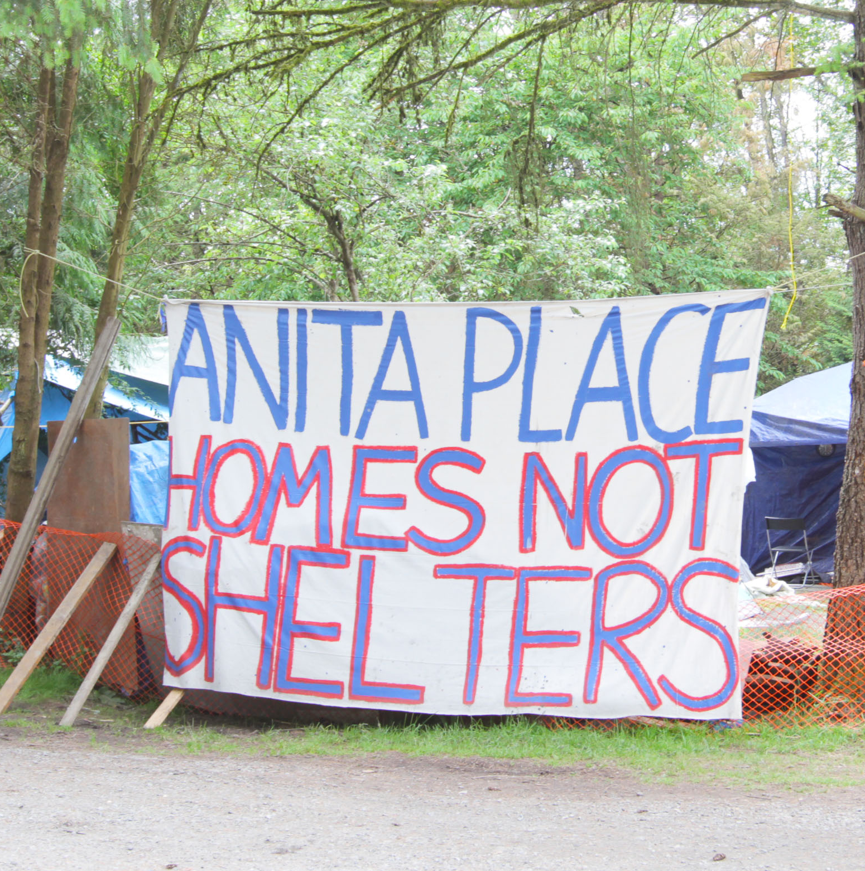
Maple Ridge should Shut down the Homeless Camp
6 arrested at Maple Ridge homeless camp
Camp in legal battle
The city obtained a court injunction on Feb. 8 in which the B.C. Supreme Court recognized the risks at the camp, including tents pitched close together, dangerous electrical wiring, and the presence of propane and gasoline near open flames.
Anita Place was established in May 2017 to protest the closure of a 40-bed shelter in Maple Ridge.
Since then, residents of the camp and their lawyers have fought off two attempts by the City of Maple Ridge to evict them in the courts.
https://www.cbc.ca/news/canada/british-columbia/anita-place-homeless-camp-arrests-1.5032117

Slide 29
It is economically smarter to House the homelessness

Slide 30
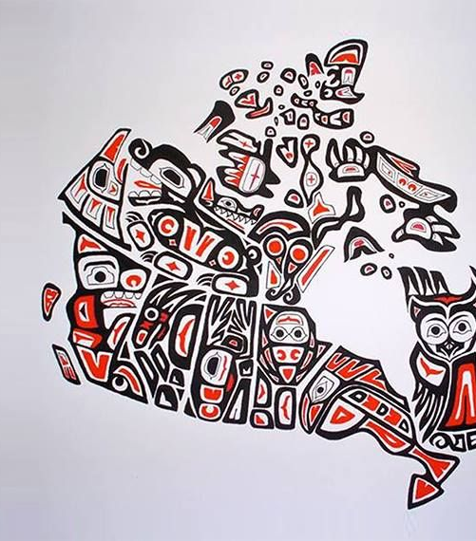
Homelessness is not an issue of poverty, it is an issue of discrimination

Slide 31
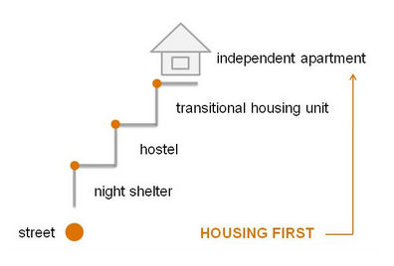
“Housing First” is the best approach to combating homelessness

Slide 32
Conclusion: Is Shelter a Human Right?
Class 8

Slide 33
What is an example of Government Policy if . .
Shelter IS a Right
Shelter is NOT a Right

Slide 34
Journal Response: Opinion: Is Shelter a Right?
Defend your opinion with
facts from your organizer and article
Personal reflection/ connections to your life and world experience
***Be sure to write the article you have at the top of your response!

