Slide 1
Ideologies
And analogies

Slide 2
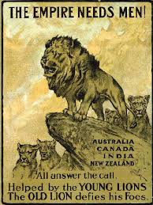
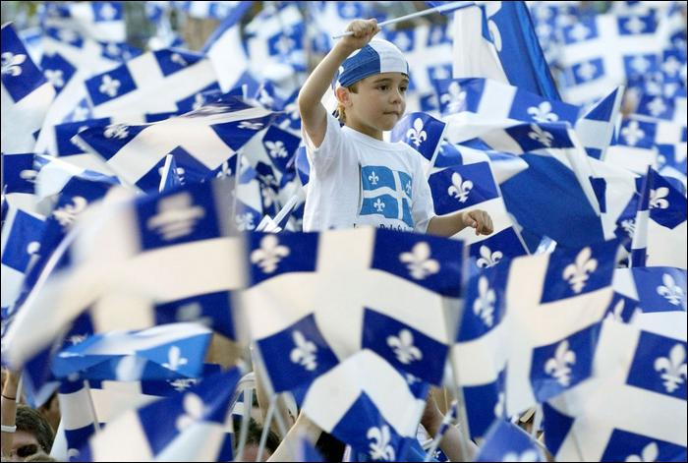
Nationalism
Intense love of one’s country, or for the common language, culture and traditions of your people
Can lead to a desire to create an independent country

Slide 3
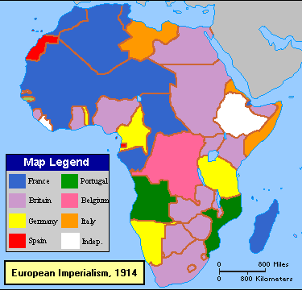
Imperialism
a policy or practice by which a country increases its power by gaining control over other areas of the world (gain land, resources, control, influence)

Slide 4
Capitalism
Cow Analogy:
“You have two cows. Sell one cow and buy a bull”
An economic system created by Adam Smith based private property and on the free market (unregulated competition). Prices, products, distribution are all determined by corporations and individuals (not the government).

Slide 5
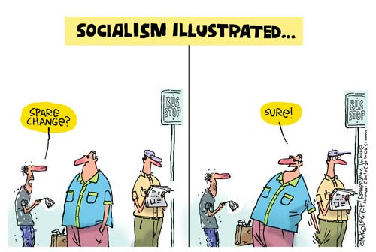
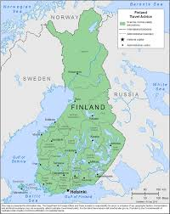
Socialism
Cow analogy:
“You have two cows. Give one cow to your neighbour.”
: a social system or theory in which the government owns and controls the means of production (ex. factories) and distribution of goods. Example: BC hydo. Government regulation and control for economic equality; basic needs of all citizens are met.

Slide 6
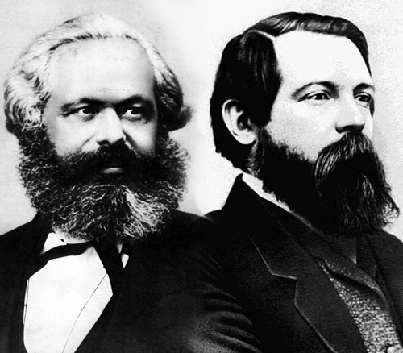
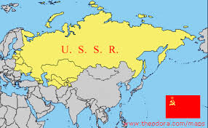
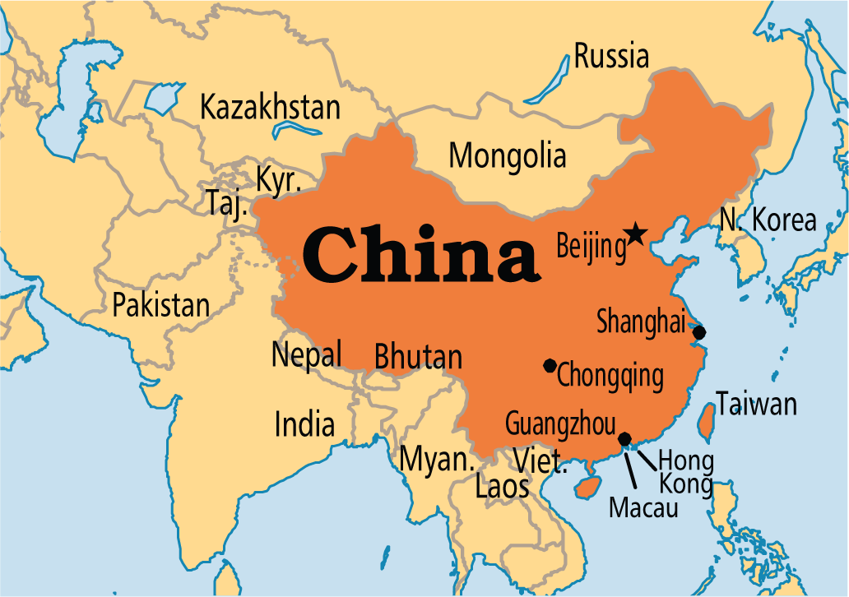
Communism
a political theory derived from Karl Marx, advocating class war and leading to a society in which all property is publicly owned and each person works and is paid according to their abilities and needs.
Karl Marx and Freidrich Engels (Communist Manifesto)

Slide 7
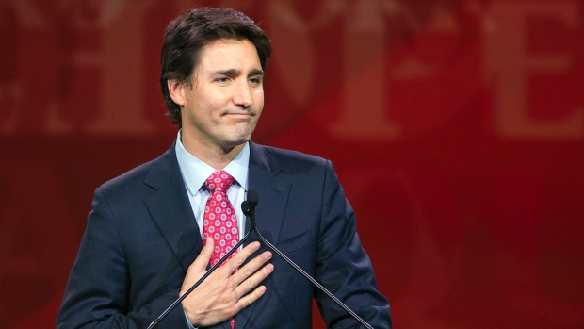
Liberalism
Liberty and equality. Personal Freedom over security of the nation. Belief in social change, both capitalism and economic supports, and the voice of the people in government.

Slide 8
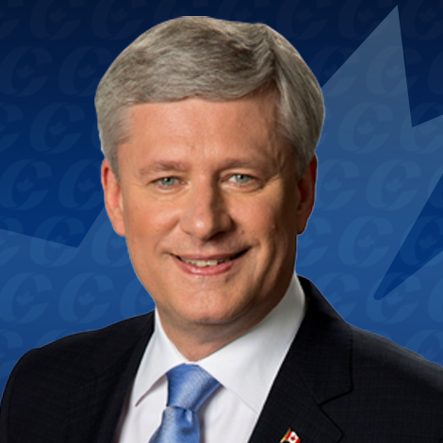
Conservatism
tradition and social stability, stressing established institutions, lower taxes, limited government regulation of business and investing, a strong national defense, and individual financial responsibility for personal needs

Slide 9
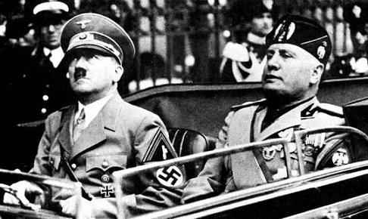
Fascism
way of organizing a society in which a government ruled by a dictator controls the lives of the people and in which people are not allowed to disagree with the government
(Military control, complete power in the dictator, extreme oppression, aggressive nationalism)

Slide 10
Quick game of “Telephone”
Write a Word on the card
Put card to back of pile
Write an EXAMPLE of the term you chose on the next card.
4. Pass the pile of cards to the person to your left.

Slide 11
Quick game of “Telephone”
Read the Example.
Put the “example” card to the back of the pile.
Draw a diagram of the example on the next card.
. Pass the pile of cards to the person to your left.

Slide 12
Quick game of “Telephone”
Look at the diagram. Put it to the back of the pile.
Write out a definition of term the diagram is most likely referring to.
. Pass the pile of cards to the person to your left.

Slide 13
Quick game of “Telephone”
Look at the definition.
Write the key term (ideology) onto the next card.
. Pass the pile of cards to the person to your left.

Slide 14
? DEFINITION: An analogy is a comparison in which an idea or a thing is compared to another thing that is quite different from it. It aims at explaining that idea or thing by comparing it to something that is familiar. Metaphors and similes are tools used to draw an analogy
What is an ANALOGY?
Example: “The structure of an atom is like a solar system. Nucleus is the sun and electrons are the planets revolving around their sun.”
Example: “Raising children requires the same dedication you would give to a garden. Nurture them, feed them, introduce them to both light and dark, and have patience; and soon you will see them grow into blooming wonders.”

Slide 15
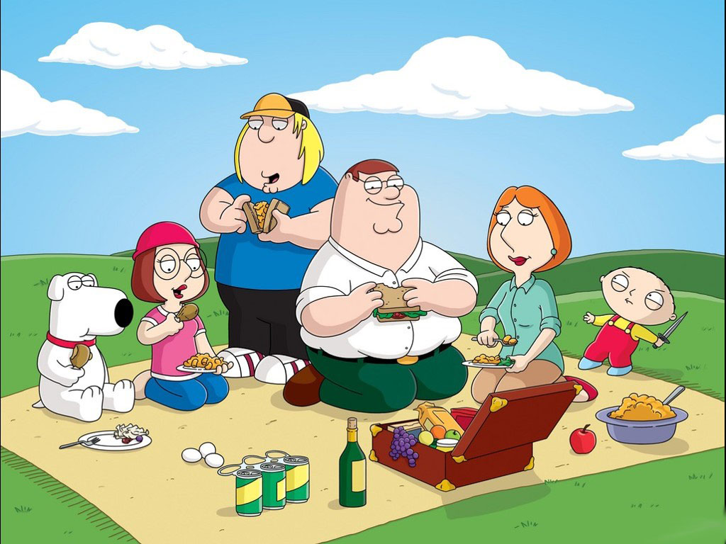
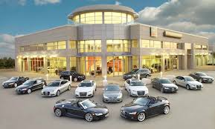
At a picnic . . .
At a Car dealership . . .

