Slide 1
If the World Were a Village of 100 People . . .
2010 Statistics and quotations from book of same title by David J. Smith

Slide 2

“The Earth is a crowded place, and it is getting more crowded all the time. As of 2010, the world’s population was more than 6 billion, 900 million. China has over 1 billion, 300 million, while India has more that 1 billion , 200 million people
How many countries have over 40 million people?
How many have over 100 million?

Slide 3
32 counties have over 40 million people
11 countries have over 100 million people
What if we imagined the whole population of the world as a village of just 100 people? In this imaginary village, each person would represent 69 million people from the real world.

Slide 4
If there were 100 people on Earth, how many would be from
  Asia?
  Africa?
  Europe?
  South America? (including central America and Mexico)
  North America?
  Oceania?

Slide 5
If there were 100 people on Earth, how many would be from
  61 are from Asia
  14 are from Africa
  11 are from Europe
  8 are from South America
  (including central America and Mexico)
  5 are from North America
  1 is from Oceania

Slide 6
Over half the people in the Global village come from the 6 most populated countries.
What are they?

Slide 7
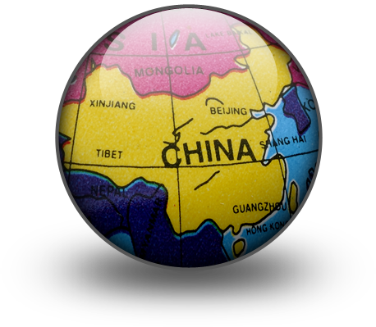
Over half the people in the Global village come form the 6 most populated countries.
20 are from China
17 are from India
5 are from the United States
4 are from Indonesia
3 are from Pakistan

Slide 8
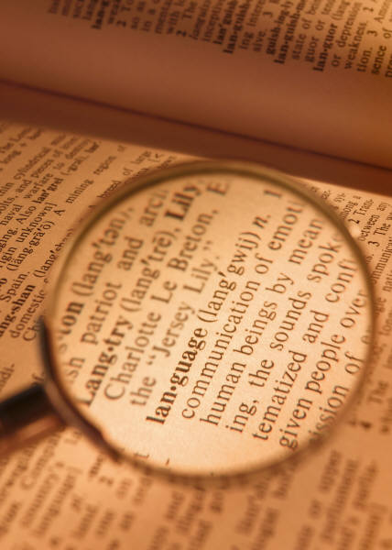
In the Global village there are almost 6000 languages, but more than half of the people speak 8 languages . . .
What are the 8 languages?

Slide 9
In the Global village there are almost 6000 languages, but more than half of the people speak 8 languages . . .
21 speak a Chinese dialect (of these, 16 are the Mandarin Dialect)
9 speak English
9 speak Hindi
7 Speak Spanish
4 speak Arabic
4 speak Bengali
3 speak Portuguese
3 speak Russian

Slide 10
In the year 1900, the number of youth (aged 1-19) was 44. The number of elderly (over 65) was 8.
What is the number of youth and elderly today?
What will it be in the year 2050?

Slide 11
In the year 1900, the number of youth (aged 1-19) was 44. The number of elderly (over 65) was 8.
Today we have 34 youth and 10 elderly
In 2050 it is predicted we will have 23 youth and 16 elderly

Slide 12
What religions do the people of the village follow? What are the top 3?

Slide 13

What religions do the people of the village follow?
33 are Christians
21 are Muslims
13 are Hindus
9 practice Shamanism/ animism/ folk religion
6 are Buddhist
2 are other religions (Sikhism, Shintoism, etc.)
1 is Jewish
15 are non-religious

Slide 14
Interesting note:
There has been a big change for two of the groups. A hundred years ago, there were 12 Muslims, compared with 21 today. And there was only one person in the village who was non-religious, rather that 15 today.

Slide 15


If there was 100 people, How many animals would there be to keep the same ratio on earth today?
How many Sheep/ goats per 100 people?
Cows/ Bulls?
Pigs?
Horses?
Camels?
Chickens?

Slide 16
Food:
If there was 100 people, How many animals would there be to keep the same ratio on earth today?
31 Sheep/ goats (per 100 people)
23 Cows/Bulls
15 Pigs
2 Horses
3 Camels
250 Chickens

Slide 17
Food:
Although there is enough food to feed all the villagers, not everyone is well fed.
how many do not have a reliable source of food and are hungry some to all of the time?
How many are severely undernourished and always hungry?

Slide 18
Food:
In a village of 100 people . . .
30 people do not have a reliable source of food
17 people are severely undernourished and always hungry
That is almost ½ the world

Slide 19
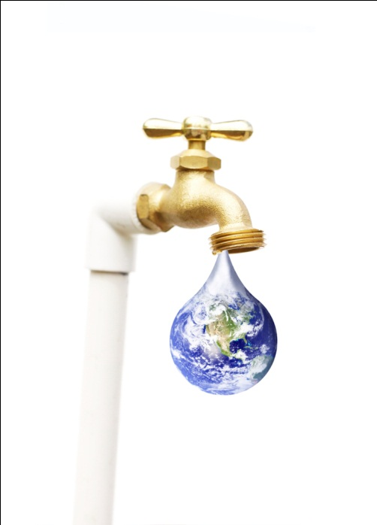

How many have access to a source of safe drinking water either in their homes or a short distance ?
How many have adequate sanitation (public or household sewage)?
How many breath clean air?

Slide 20

87 have access to a source of safe drinking water either in their homes or a short distance
13 do not
62 have adequate sanitation (public or household sewage)
38 do not
68 breath clean air
32 do not

Slide 21

If all the money in the village was divided equally, each person would have about $10 300 US per year. But the wealth is not equal.
How much will the richest 10 people make?
Poorest 10 people?

Slide 22
If all the money in the village was divided equally, each person would have about $10 300 US per year. But the wealth is not equal.
Richest 10 make $87 000 per year
Poorest 10 people make $ 700 (about $2 per day)
The lowest 50 people average $6 per day

Slide 23
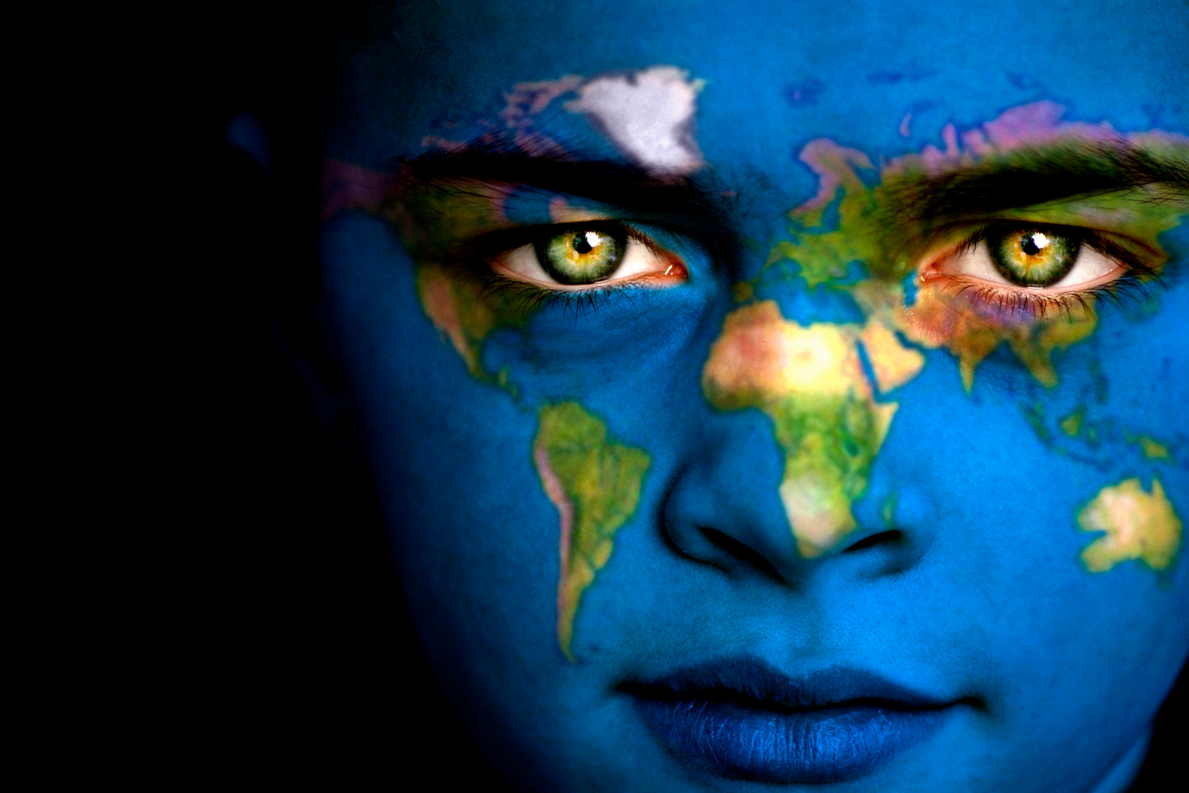
The 3 themes of this unit are . . .

Slide 24
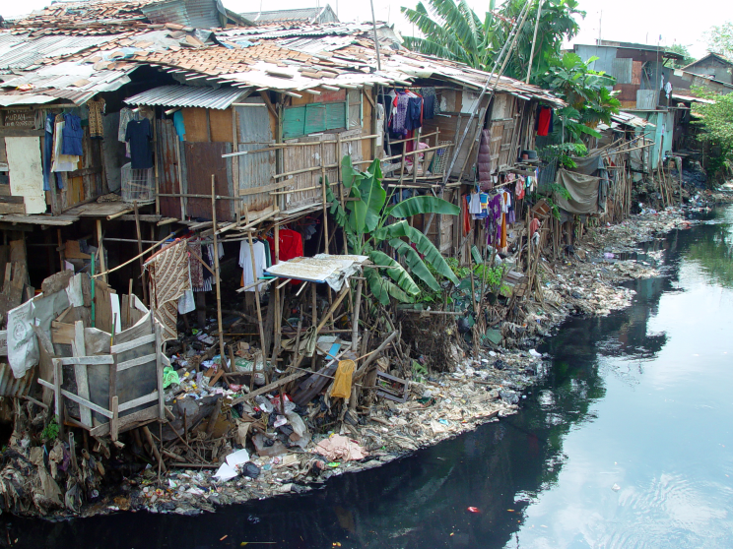
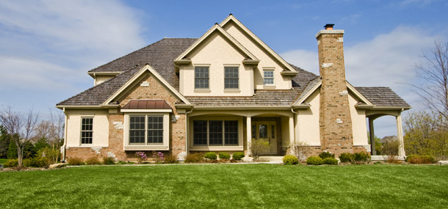
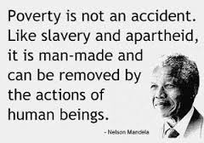
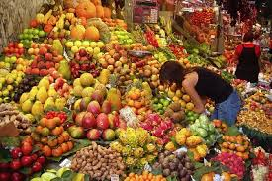
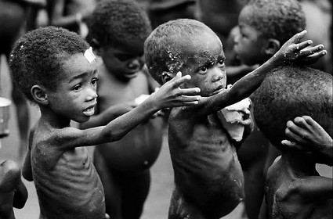
Why is wealth uneven around the world?

Slide 25
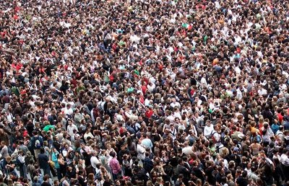
What are the problems associated with population growth?

Slide 26
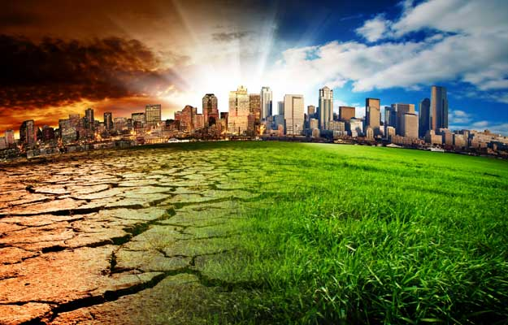
How are we affecting our environment?

