Slide 1
Iroquois & the Great Lake/ St. Lawrence Region

Slide 2
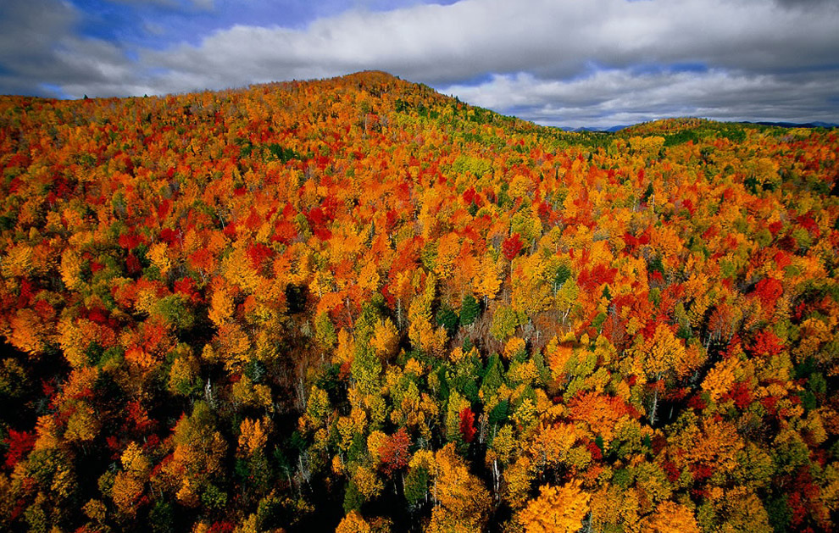
Where did the Iroquois live?
What is the topography of this region?
What is the climate?
What is the vegetation?
St. Lawrence Lowlands and the Iroquois Notes
St. Lawrence lowland/ Great Lakes region
Rolling hills, deep river valleys, flat plains
Humid, continental climate,
Continental climate = large temp. Range (high and low), low precipitation
Very fertile soil
Many deciduous and coniferous trees (ex. Maple, beech, oak, ash, spruce, fir, pine, etc.)

Slide 3
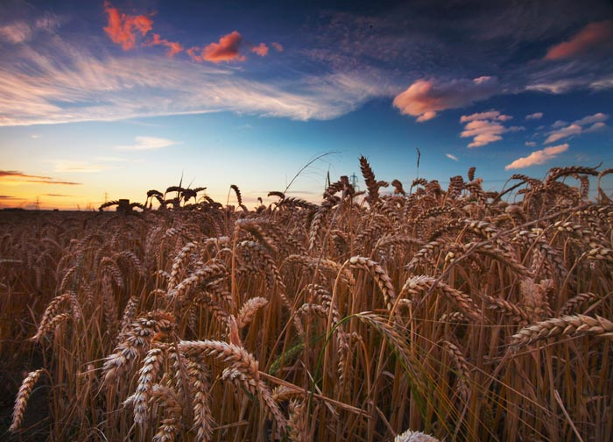
What did Iroquois society look like? What is a palisade?
What crops do they grow?
What is the impact of farming?
What housing do they have?
What is a hearth?
Iroquois live in Large towns with log palisades
Palisade = defensive fence
Have Agriculture: Fields of maize, beans, squash, sunflowers
Grow tobacco to trade
Farming allows villages to grow rapidly & stay in one place
Rows of longhouses – all extended family in one
Long house divided into hearths for each family
Hearth = family fire (private area)

Slide 4
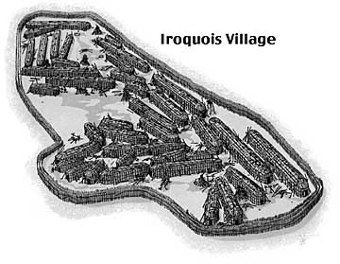
Iroquois Village

Slide 5
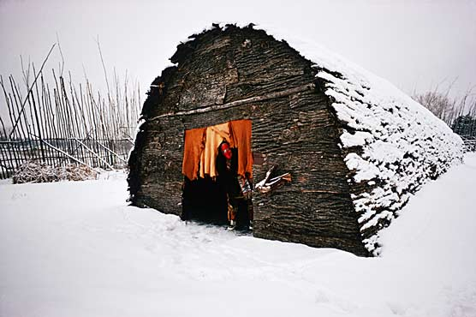
Iroquois Longhouse

Slide 6
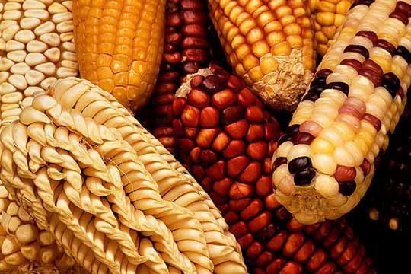
How were women important?
What is Matrilocal and Matrilineal?
What is the local government?
What is the women’s role in local gov.?
Women own crops, fields, and tended/ harvested
Matrilocal = Married couples live with brides family
Matrilineal = descent from generation to generation recorded through women
Local gov. = 2 chiefs from each extended family (civil and military chief)
Civil chief: clan activities
Military chief: defence
Women chose local chiefs and could remove them

Slide 7
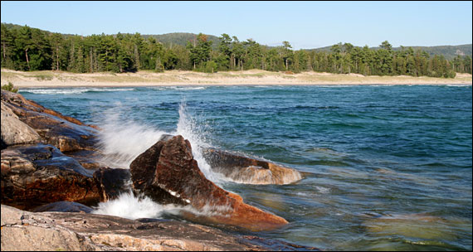
What are the other 2 levels of government?
What is the Iroquois confederacy?
How is the government chosen?
Regional council (gov.) – reps from each town
Confederacy council – for entire nation – reps from each nation/tribe
Iroquois Confederacy is 5 nations joined to 1
Nations: Mohawk, Oneida, Onondaga, Cayuga, Seneca
Democracy at all levels of gov.

Slide 8
Summary Paragraph
How did the Physical Environment of the St. Lawrence lowland/ Great lakes region influence the culture of the Iroquois?

Slide 9
Questions: p. 197 # 1 and 2
What were the effects of the development of agriculture among the Iroquois? Advantages and disadvantages of agriculture?
Staying in one place, developing a strong government, growth of villages
Advantage: ready food supply, not nomadic (permanent housing), can develop defences
Disadvantage: poor crop, no food, no where else to go – must defend home
How was Iroquois society democratic? Why were women so important to its development?
Democratic: Vote in leader, can remove them, representatives form each family, then village, then tribe
Women: vote in civil and military chiefs, and can vote them out

