Slide 1
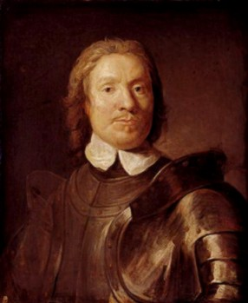
Oliver Cromwell

Slide 2
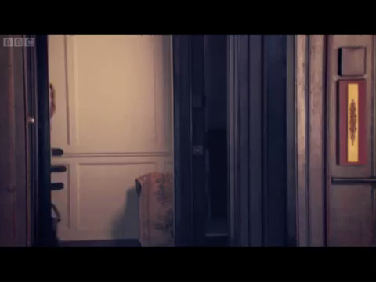
Oliver Cromwell - portrait

Slide 3
Cromwell is in charge 1653 – 58
Signed death warrant of king Charles I
Puritan, and believed everyone should live by strict rules
  Put in new laws (blue laws)
  Enforced laws with soldiers
  Blue laws disallow:
    Feasts (including Christmas)
    Decorations
    Make-up on women
    Sports
    Fancy clothes
    Theatre/ entertainment

Slide 4
Cromwell did not follow the rules himself
Hated Irish Catholics
People hated Cromwell and Blue laws
Died in 1658
Richard (son) takes over briefly
Charles II is then asked back

Slide 5

Oliver Cromwell – Charles II

