Slide 1
What do you see?
Picture analysis

Slide 2
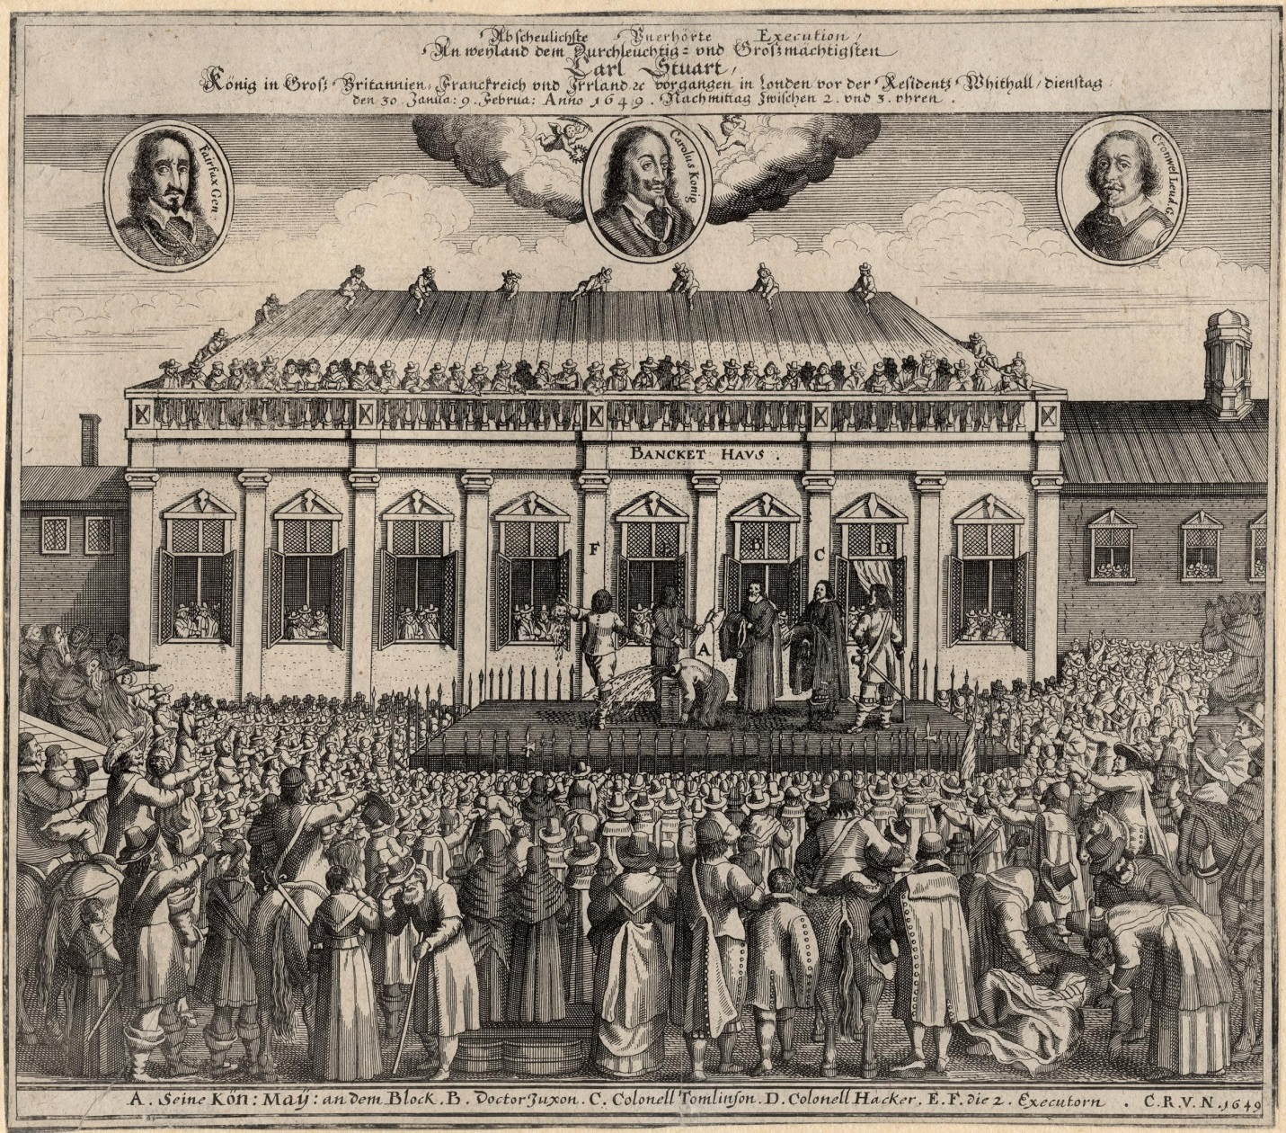
1. observation: What do you see?

Slide 3

2: Hypothesis: What do you think is going in in this picture? Based on what observation?

Slide 4
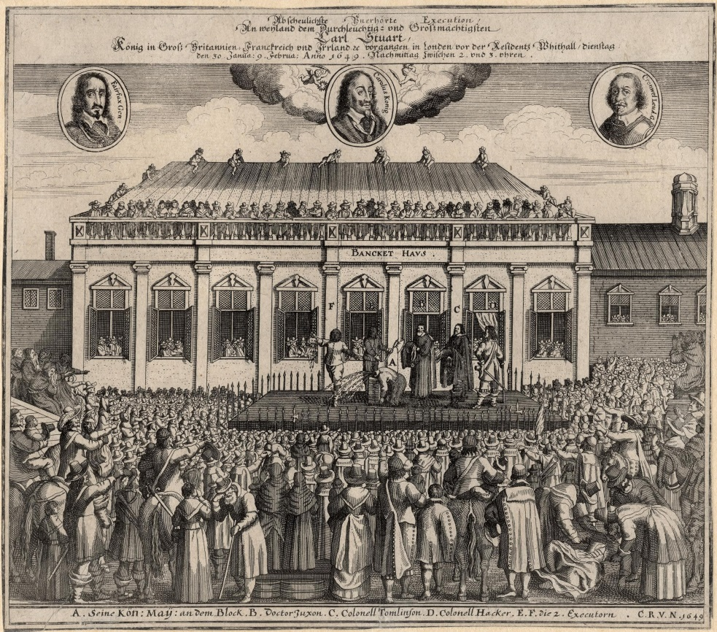
2: adjust Hypothesis based on additional information
Oliver Cromwell is quoted stating it was a “Cruel Necessity”
“It is impossible to describe the grief, indignation, and astonishment which took place.....throughout the whole nation, as soon as the report of this fatal execution was conveyed to them..”
- David Hume, author of The History of England)
January 30, 1649

Slide 5
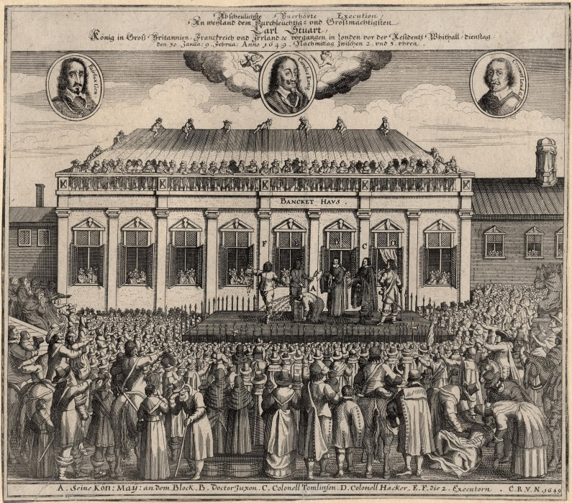
Share your ideas!
Line up according to how confident you are in your answer

Slide 6
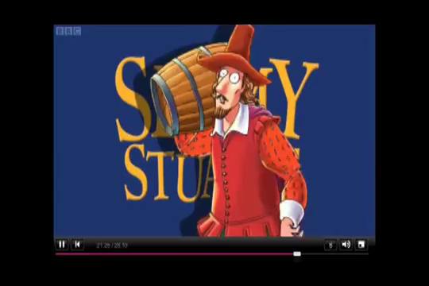
What is the picture really about?

Slide 7
Questions?
What Questions do you still have?

Slide 8
Questions?
1. Why would the parliament want to kill their king?
2. Such a drastic change is called a revolution.
Do you know of any other revolutions?

