Slide 1
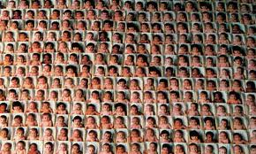
Population
The Global Impact of 7 billion people

Slide 2
7 billion and Counting

Slide 3
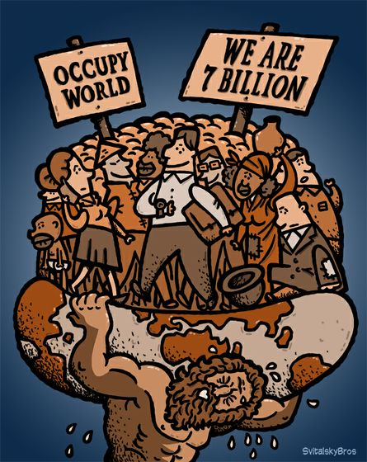
What is 1 billion, Really? You have lived a million seconds when you are 11.6 DAYs old, and 1 billion seconds when you are 31.7 YEARS old
The World has 7 Billion People and is rapidly, exponentially increasing. So what? What does that really mean?

Slide 4
What is Exponential Growth?
Lets tell a story by Al Barteltt (mathmetician) to help you understand exponential population growth.
Imagine bacterium growing steadily in a bottle. They double in number every minute.
At 11:00 am there is 1 bacterium in the bottle.
At 12:00 noon the bottle is full.

Slide 5
Question:
At what time would the bottle be ½ full?
11:59
Because they bacteria double in number every minute
Question:
If you were the average bacterium in the bottle, at what time would you first realize that you were running out of space?

Slide 6
Let’s look at the facts:
11:54 – 1/64 or 1.6% full
11:55 – 1/32 or 3.1% full
11:56 – 1/16 or 6.3% full
11:57 – 1/8 or 12.5% full
11:58 – ¼ or 25% full
11:59 – ½ or 50% full
12:00 – 100 % full
With only 5 mins left, and 97% of the bottle empty, how many of you would have realized there was a problem?

Slide 7
Suppose that at 11:58am some of the bacteria realize that they are running out of space. So they embark on a great search for new bottles. They search offshore and in the arctic and find
3 new bottles.
WOW! What a find!
How long can the growth continue as a result of the 3 new bottles?
2 minutes.
12:00 – 1 bottle is full
12:01 – 2 bottles are full
12:02 – 4 bottles are full
Conclusions?
Exponential growth cannot be maintained.

Slide 8
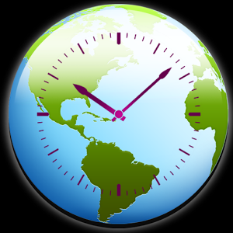
What is the problem with too many people? Let’s look at our world.
See “World Clock” http://www.worldometers.info/world-population/
What stands out to you? What questions do you have?

Slide 9
Article: Build the story from the clues:
“. . They now find it easy to forget the body buried beneath its floor.”
“We have to do regular ward checks to make sure none of the mothers are sleeping on the babies and suffocating them.”
“the people have the choice of either coming down to this beach to go to the toilet or using a plastic bag in their homes”
“The planet is running out of space”

Slide 10
What is the problem with too many people? Let’s look at our world.
Read TheGuardian Article (2010) on the Philippines : “Manila: a megacity where the living must share with the dead”
Reading Focus: What are the impacts of rapid population growth?

Slide 11
How and where is the population growing? Some key words to know . . .
Birth rate
The average births in a country per 1000 people
Death rate
The average deaths in a country per 1000 people
Life Expectancy
The average life span in a given country

Slide 12
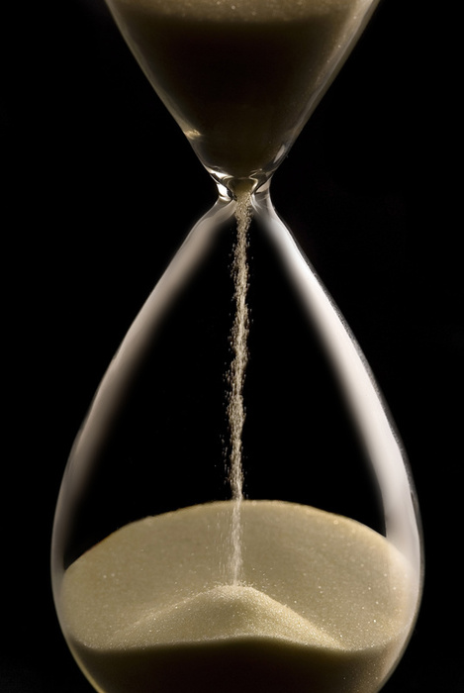
Life Expectancy
… is an average
-low or high life expectancies do NOT mean everyone lives longer or shorter lives in that country
low = when child-
deaths are common
- For example, It is low in Burundi (50 years) not because all die at 50, (manhy live to old age) but because of the many infant deaths added into the average

Slide 13
Vocab check create a Student-Friendly DEFINITION and a DIAGRAM to illustrate the meaning of the following words (in groups)
Demography
Doubling time
Infant mortality rate / child mortality rate
Life Expectancy
Net Migration
Total Population growth
Birth / Death rate
Fertility rate
Demographic Transition

Slide 14
What is the problem with too many people?
Create class brainstorm of problems associated with overpopulation.
to consider:
Why are some places growing rapidly while others are not?
Are there connections between life expectancy and population growth?
Is there a connection between wealth and population growth?

Slide 15
World Population
I used to think. . . .
and now I think . . . .

Slide 16
In case you were wondering and didn’t want to ask . . .
If we eliminate poverty, eliminate child Mortality, and raise the life expectancy of the world . . . .
Will this lead to Rapid Overpopulation? Will this make all our other problems worse?

Slide 17
Has Rosling: Will saving poor children lead to overpopulation?

Slide 18
The Demographic Transition Model – how we think we can stop overpopulation

Slide 19
In case you were wondering and didn’t want to ask . . .
If we raise the standard of living for everyone, so everyone on earth gets a good home, food, healthcare and technology . . .
Won’t we use up all the resources on earth? Is the better idea to keep some people poor?

Slide 20
Hans Rosling and the Magic Washing Machine: the problem is we use too much – Rule of Kindergarten - SHARE

Slide 21
Solutions to population growth
I used to think. . . .
and now I think . . . .

