Slide 1
Hitler’s rise to power
The 1920/30s

Slide 2
1. With increasing violence . . .
Should Metal detectors be placed in High Schools?

Slide 3
2. In the aftermath of terrorist attacks . . .
Should the Government be able to listen in on cell phone calls / texts?

Slide 4
With events like “Charlottesville” . . .
should there be limits to free speech?

Slide 5
4. In the times of “fake news” . .
Should the Media be restricted?

Slide 6
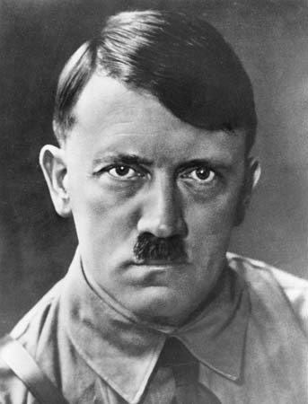
The Rise of Adolph Hitler Organizer – 8 boxes 1: Hitler (man and beliefs) 2: Political rise to Power 3: Nazi Party’s 25 points 4: propaganda (“selling murder) 5: Hitler’s Economic Policy 6: Hitler’s Social policy 7: Hitler’s Political Policy 8: evidence of militarization

Slide 7
Box 1: Hitler - man and beliefs
“Hitler: Oversimplified”: https://www.youtube.com/watch?v=ATlila3e9dM
‘History Brief: Hitler’s Rise to power”
https://www.youtube.com/watch?v=tkTjNHwbITg

Slide 8
BOX 2Video: Hitler’s political rise to power (5 mins):

Slide 9
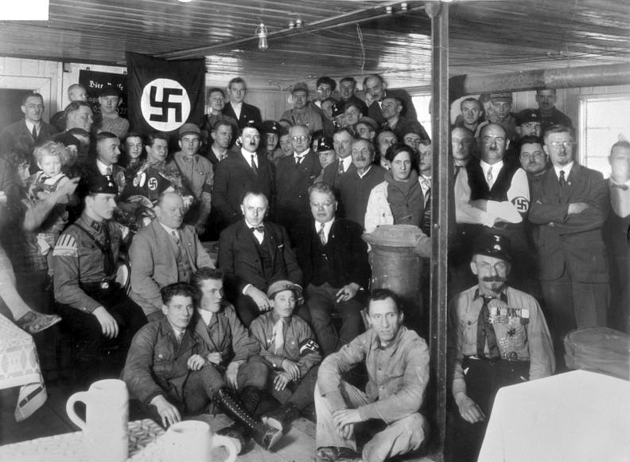
“25 points” – the promises: (box 3)
READ the 25 points of the “National Socialist German Workers Party” (Nazis)
Big Ideas: state 5 themes / Ideas behind the “25 points”
(What does the Nazi party stand for?)

Slide 10
Box 4: Propaganda: control the media control the people
Propaganda: “Love, Hate and Propaganda” episode 2 – selling the war -“selling murder” (8 minutes)
How does Hitler get support for a genocide?
(Methods of Propaganda)

Slide 11
TASK: multiple sources: (box 5/6/7/8)
Video clip: “Nazification of Germany” (5 mins) https://www.youtube.com/watch?v=zRprGgtyWRc
2. Each group takes 1 source on handout –
Summarize the source
Analysis: How is this source connected to Hitler’s ability to gain total power?
IDENTIFY:
Social, Economic, Political, Military Policy

Slide 12
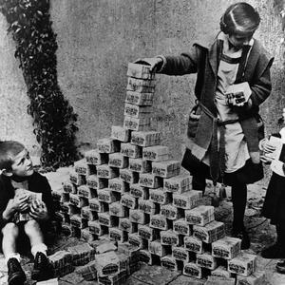
Handout - chart: The Historical Context of the 1920s:
Remember: Weimar Republic, Dawes Plan, 1929, depression:
Create Timeline of events: What specifically happened?
Conclusions: What conditions are needed to allow democracy to fail?
Oversimplified – Hitler – Part 2
https://www.youtube.com/watch?v=Dd1JUTA7Ijc

