Slide 1
Russian Revolution 2
RISE OF STALIN

Slide 2
Class 5: WHO is Joseph STALIN?

Slide 3
Warm up: Quick Philosophical Chairs
Is it ok to sacrifice 1 life to save 1000 lives?

Slide 4
Warm up: Quick Philosophical Chairs
What process makes better decisions:
a. group consensus
b. a single individual

Slide 5
Warm up: Quick Philosophical Chairs
Do the Ends justify the Means?
(if the end result is good, does it matter what was done to get there?)

Slide 6
What can we predict about Stalin? (handout)

Slide 7
Who was STALIN? What can learn about him from the sources?

Slide 8
What did Stalin Do economically? 5 year plan NOTES
Evaluate the Notes of your Neighbour!

Slide 9
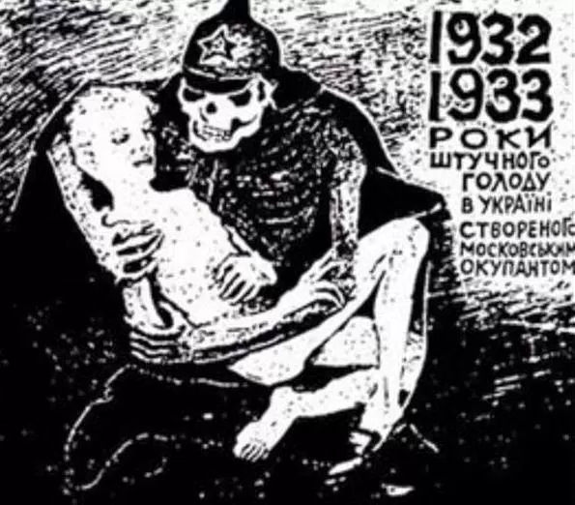
Class 6: Collectivism and the Ukraine

Slide 10
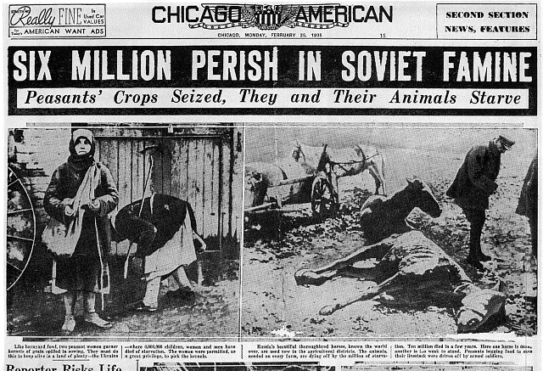
Events of the Ukraine: Summary (collectivism and Ukraine articles – annotate and compare)

Slide 11
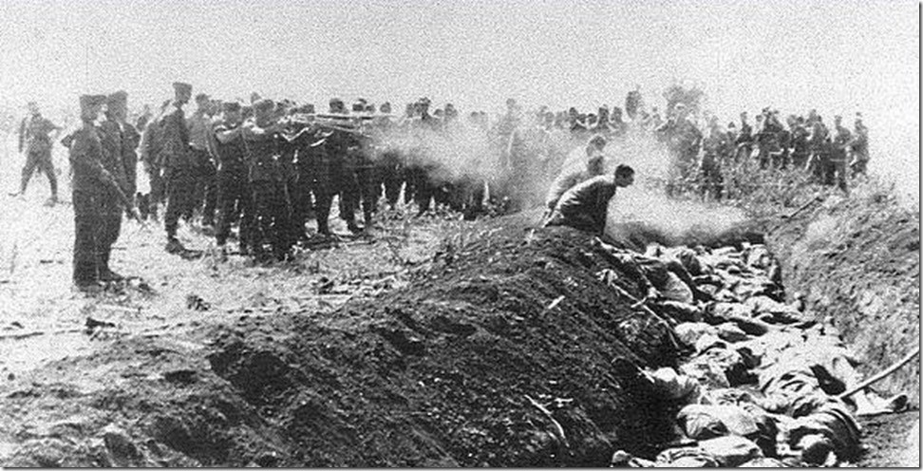
Class 7: Purges and Gulags

Slide 12
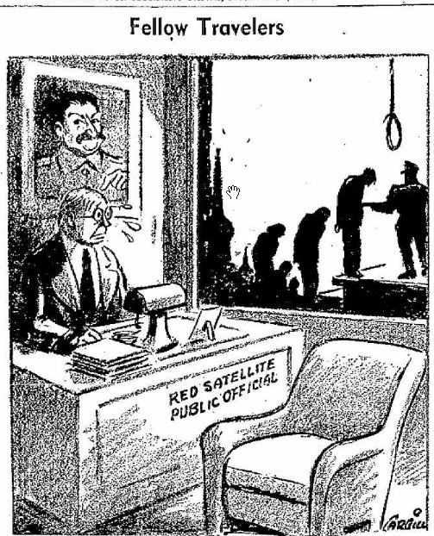
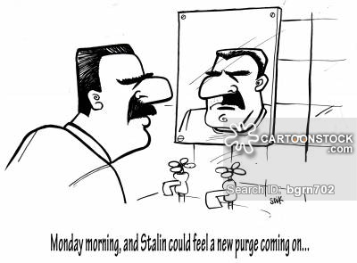
Stalin’s Purges: Source analysis

Slide 13
Class Placemat activity: in your individual sections:
What makes a Great Leader?
List as many characteristics as possible
What is the most important trait of an effective leader? Group consensus into the center box

Slide 14
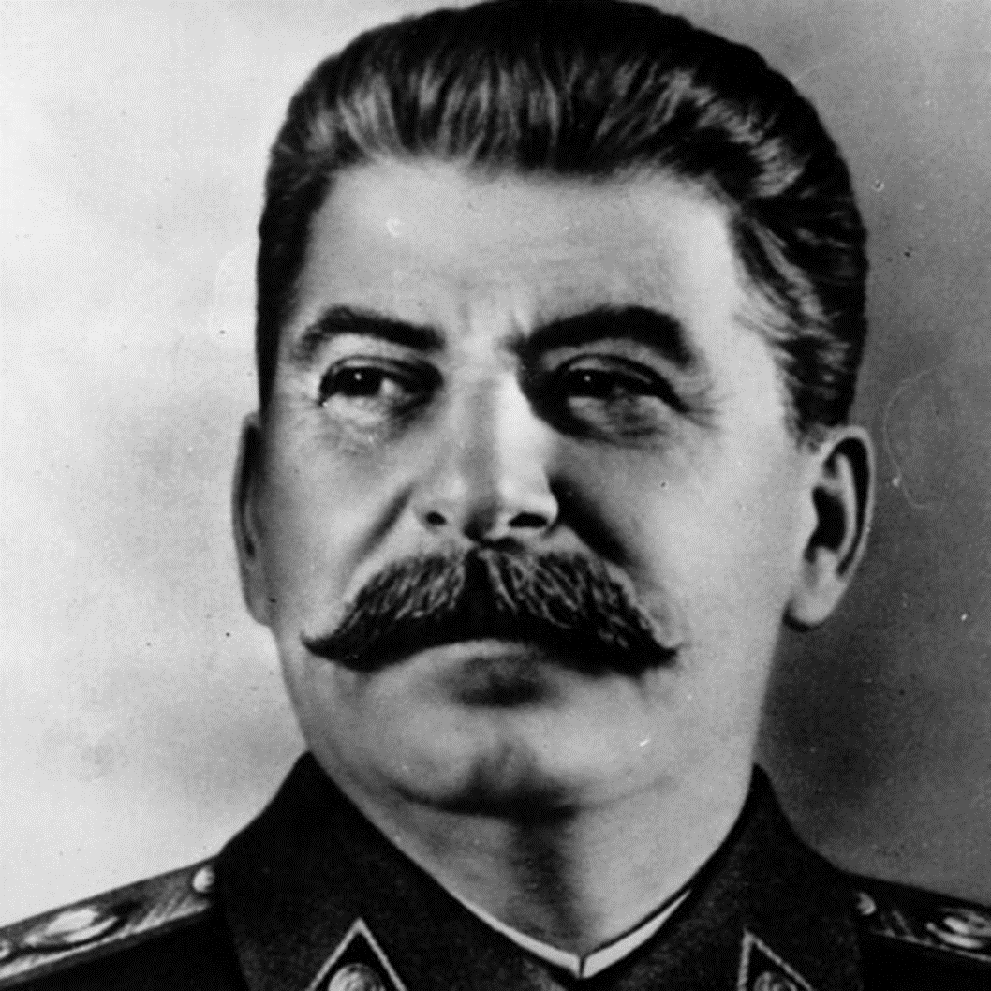
Purpose: Was Stalin a Great Leader?
Sort the Words Provided into 4-5 Categories.
Glue them down to the Big Paper in a WEB.
Write Details / add notes / define each term (use 1 colour)
Create Connections between terms by drawing lines– write Why they are connected on the line
Analysis: Evidence Stalin was a good Leader / Evidence he was not

Slide 15



